Slide 1

VUA General Assembly 2018
The One Health Concept in the Curriculum
Dr. Susanne Lehnert
Management Board member of EQA Sce,
FoodNetcenter Bonn

Slide 2



International
Network
– internationally oriented educational offerings of the EQA provide intercultural competence
– chain oriented all actors – from agricultural production over
food processing to retail – are involved
– standard oriented the most important international standard
setters are involved
– lifelong oriented individual qualification paths are depicted in
a platform for education and registration

Slide 3
Members
Knowledge Providers
  Andreas Hermes Akademie im Bildungswerk
  der Deutschen Landwirtschaft e.V.
  Department of Agricultural Economics and Rural Development (DARE) of the Georg-August-Universität Göttingen
  Deutscher Fruchthandelsverband e.V.
  GIQS e. V. Interessengemeinschaft Grenzüberschreitende,
  Integrierte Qualitätssicherung
  International Center for Food Chain and Network Research
  KIGPSiO3 – Economic Chamber of Food Industry (Poland)
  Freshmazovia.com (Poland)
  Biuro Promocji Jakości [Engl. Quality Promotion Office] (Poland)
Standard Bodies
  FoodPLUS GmbH
  GS1 Germany GmbH
  IFS Management GmbH
Certification Bodies
AGRIZERT Zertifizierungs GmbH
DNV GL Business Assurance Zertifizierung & Umweltgutachter GmbH
Companies
  Eitco GmbH
  PigCHAMP Pro Europa (Spain)
  Veravis GmbH
  EWA-BIS (Poland)
  CSB-System AG
  EPG Assistant GmbH
  Chainpoint b.v.
  Perino Sp.z.o.o.
Personal Members
Lecturers, Experts and Consultants

Slide 4
Vision and Mission
Becoming a leading promotor of education in quality, risk and crisis management in global feed and food chains
Improving national and international quality infrastructure to enable educational compliance
with existing standards
(e.g. IFS, BRC, GlobalG.A.P., GS1, GMP+ …), knowledge
and application of quality
and food safety & health requirements of global markets
Establishing an autonomous, neutral institution actively involved in the work of international organisations
of quality, environment, health and safety and crisis management, sustainability and cooperate social responsibility (CSR)
→ Accreditation Agency for personnel certification an the agri-food area

Slide 5





Slide 6
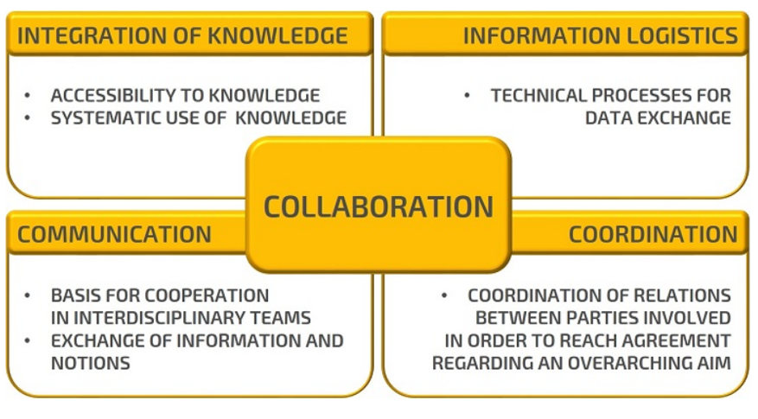
One Health –
international and interdisciplinay

Slide 7
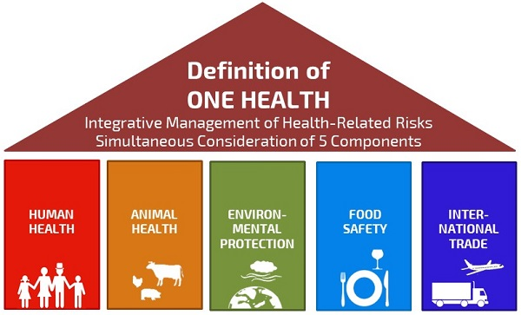
One Health – Definiton

Slide 8
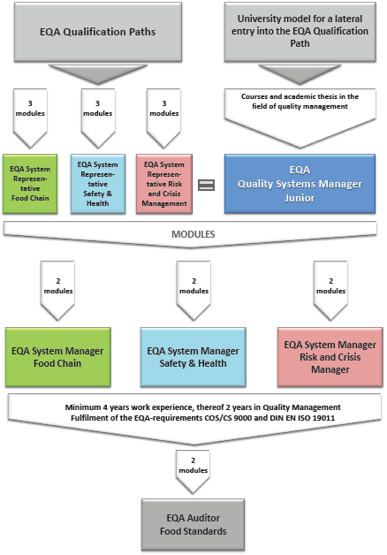
EQA
Qualification
Paths
EQA
Food Safety & Health
Manager

Slide 9
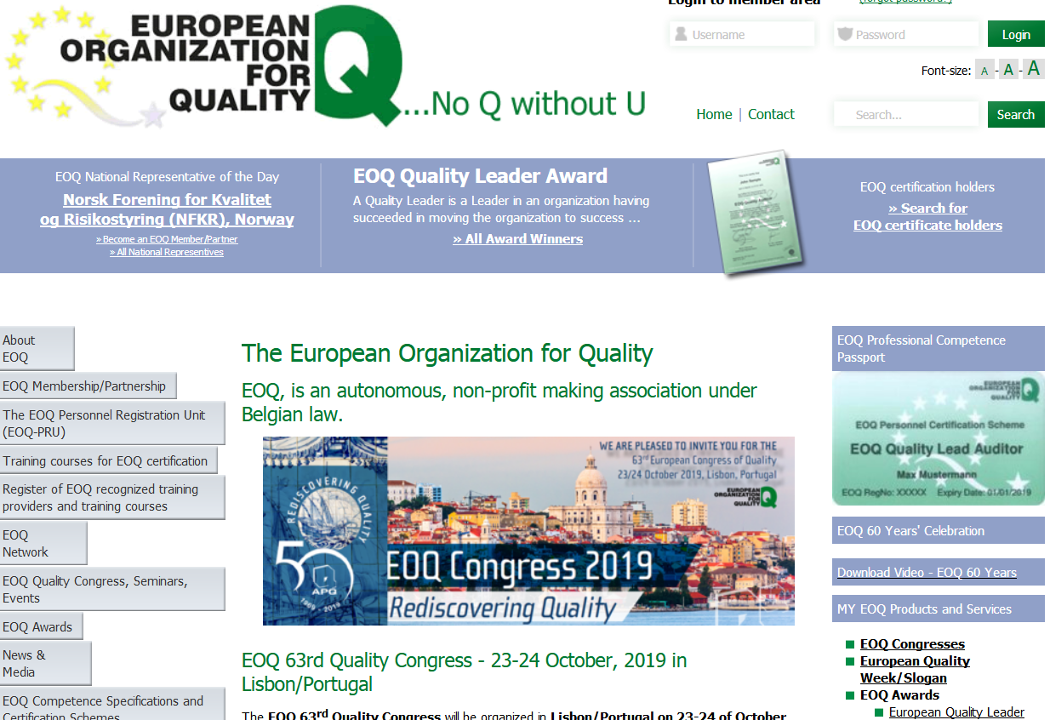
EQA academic education based on EOQ
C
EOQ Competence and certificatin schemes (CoS 9000)

Slide 10


Additional qualification
Quality Systems Manager Junior (QSMJ)
More than 13 Universities in Germany since 1996
-> advisory committee “Research + Teaching”
Qualification scheme with specific courses
and exams in 3 blocs
  Bloc I Lectures and exercises (min. 100 hours)
  Bloc II Seminars and group work (min. 40 hours
  Bloc III Practical activity (min. 200 hours)
All blocs are covered by specific course
modules and the associated exams at the
universities (accredited by the DGQ)
One professor as authorized coordinator at each university
-> member of DGQ advisory committee “Research + Teaching”

Slide 11



Actual academical QM courses
at university level
MSc Food Quality Management
subjects
MSc Agr Science / MSc Food + Nutrition Science
academic qualification, branches
academic qualification, DGQ (national)
orientation
QSMJ Quality Systems Manager Junior (DGQ)
---
certificate
Responsible Prof
coordination
Prof. Dr. Petersen
Common EOQ oriented QSM Junior Program

Slide 12
Overview of the study programme
FQM Wageningen
Second
year
Credits/year
THESIS, 36 CREDITS
INTERNSHIP or minor THESIS, 24 CREDITS
24 or 36
ADVANCED
FOOD QUALITY
MANAGEMENT
12 CREDITS
FOOD LAW
6 CREDITS
MODULAR SKILLS TRAINING
3 CREDITS
DISCIPLINE COURSE 2
Food Logistics Management
6 CREDITS
FOOD ETHICS
3 CREDITS
First year
FOOD QUALITY
ANALYSIS AND
JUDGEMENT
6 CREDITS
RESEARCH DESIGN &
RESEARCH METHODS
6 CREDITS
60
DISCIPLINE COURSE 1
Case Studies Management
6 CREDITS
BASIC
FOOD QUALITY
MANAGEMENT
6 CREDITS
STATISTICS
6 CREDITS
CONTEXT
METHODS
FOCUS

Slide 13
EOQ criteria with QM education in food Safety & Health
1 Quality Management
2 Organization of quality function
3 Processmanagement principles
4 Quality improvement techniques
5 Ressource manngement
6 Quality in logistics and sales
7 Design and development in process
management
8 Purchasing and subcontracting
9 Production and service process
10 Monitoring and measurement of
process /product
11 Data collection and analysis
12 Inspection, testing and metrology
13 Control of nonconformity
14 Social aspects
15 Legal and regulatory aspects
15 critieria for
Quality Systems Manager Junior
EOQ criteria for QM education & trainings
Inventory of Courses
for QSM Junior

Slide 14
EOQ qualification criteria (CoS 9000)
1 QM Standards+guidelines 2 Quality function 3 PM principles 4 Q improvement
13 Nonconformity
Level C
1 QM basics 5 Resource Man. 6 Q in logistics
7 Q in design+develop. 8 Purchasing 9 Production+ service 10 Monitoring 11 Statistics 14 Social aspects
Level B
Level A
12 Inspection
Level A= To understand and to be able to explain;
Level B= In addition to A, to be able to indicate relevant methods and to apply them;
Level C= In addition to B, to elaborate and integrate relevant methods and to interpret the results.

Slide 15


Knowledge and Registration Platform
EQA
FOOD SAFETY & HEALTH MANAGER
Pool of Lecturers & Experts
Individual EQA Registration Number 0000000000000
Registration & Recognition Procedures
Knowledge and Registration Platform
Agricultural Enterprises & Organizations
Food Enterprises
& Organizations
Higher Education Bodies
(Universities, Colleges)
Public Bodies
& Organizations
Standard Providers
& Certification Bodies

Slide 16



Invitation
SEPTEMBER 2018

Slide 17


Slide 18

Food & Human Safety
Global Chains
QM in Food Chains
Innovation towards
sustainable Food & Human Safety
New Approach to Stimulate Sustainable Development
Prevention of Zoonosis
and Emerging Diseases
Risk Management
One Health
Data Base for Early
Warning Systems
Crisis Management
Invention and Innovation
Research Cooperations
Cold Chain and Waste Management
Integrated Management
Cross-Faculty Partnership for Education & Training
Construction of
Joint Projects
Management of
Joint Projects
Delegation Visits
Cooperative Study Courses
PR for the TUN EQA
Joint Summer Schools
Scientific Publications
Exchange of Trainers
Strategy and Project Meetings
Cross-Sectional
Tasks
Workshops
Coordination of Joint Projects

